Slide 1
EMPLOYEE DATA ANALYSIS USING EXCEL
STUDENT NAME: Lokeshpraveen k
REGISTER NO: 312211636
DEPARTMENT: COMMERCE
COLLEGE : Thiruthangal Nadar College

Slide 2
PROJECT TITLE
Employee Performance Analysis using Excel

Slide 3


AGENDA
Problem Statement
Project Overview
End Users
Our Solution and Proposition
Dataset Description
Modelling Approach
Results and Discussion
Conclusion
3/21/2024 Annual Review

Slide 4

PROBLEM STATEMENT
1.Data Collection and Organization
2. Effective Visualization
3. Efficiency and Automation
4. Fair and Objective Evaluation
5. Identifying Trends and Outliers
6. Comparing Across Metrics and Time Periods

Slide 5

PROJECT OVERVIEW
Data Collection and Preparation
Selecting the Right Template
Customization and Data Entry
Visualizing Performance Metrics
Interpreting the Data
Communication and Reporting
.

Slide 6
WHO ARE THE END USERS?
Managers and Team Leaders
Human Resources (HR) Professionals
Executives and Business Owners
Employees Themselves
Project Managers and Project Teams
Consultants and External Auditors
Training and Development Specialists

Slide 7

OUR SOLUTION AND ITS VALUE PROPOSITION
1.Conditional formatting- missing
2.Filter- remove
3.Formula- performance
4.Pivot-summary
5.Graph- data visualizations

Slide 8
DATASET DESCRIPTION
1.Project Management Sample Data
2. Inventory Records Sample Data
3.Call Center Customer Satisfaction Data
4. Supermarket Sales Sample Data
5. Employee Management Data
6. Technological Product Sample Data
7. Engineering and Manufacturing Sample Data
8. Students Marksheet Sample Data

Slide 9

THE "WOW" IN OUR SOLUTION
•Performance level =IFS( Z * 8 >= 5 “VERY HIGH” Z * 8 >= 4 “HIGH” mathcal , Z * 8 >= 3 ,”MED”,TRUE,”LOW”)
3/21/2024 Annual Review
‹#›

Slide 10
MODELLING
1.Data collection
2.Feature collection
3.Data cleaning
4.Levels
5.Summary
6. Visulaization
‹#›

Slide 11
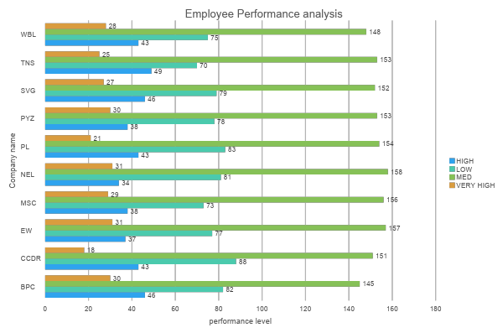
RESULTS
‹#›

Slide 12
CONCLUSION
1. Excel Templates: Excel provides ready-to-use templates for evaluating employee performance. These templates capture essential information and focus on performance goals, allowing you to assess different dimensions of performance.
2. Customization: Customize these templates to fit your organization’s specific needs. However, consider complementing Excel with specialized HR software for enhanced collaboration and automation.
3. Visualize KPIs: Use Excel’s features to highlight key performance indicators visually, ensuring meaningful insights for managers and executives.
Remember, thoughtful performance analysis contributes to organizational effectiveness and growth!

